Slide 1
The long March… April 2012, Strasbourg, CEIPI
Bruno VAN POTTELSBERGHE ,
Dean, Solvay Brussels School of Economics and Management, ULB
bruno.vanpottelsberghe@ulb.ac.be

Slide 2
So far…. Since 1958, or 1978…
A non- European ‘European’ patent

Slide 3
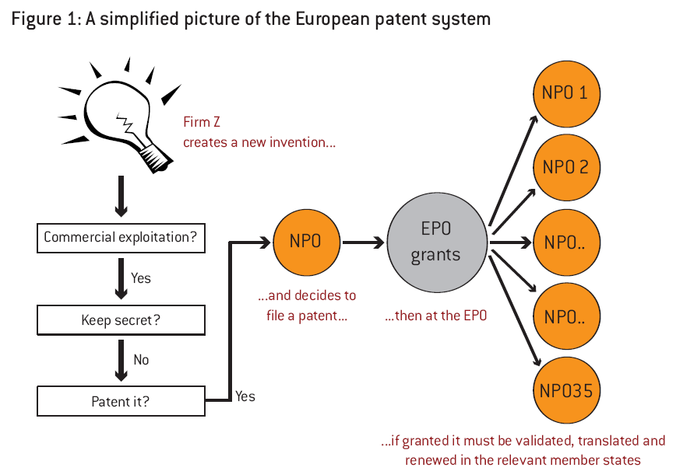

Slide 4
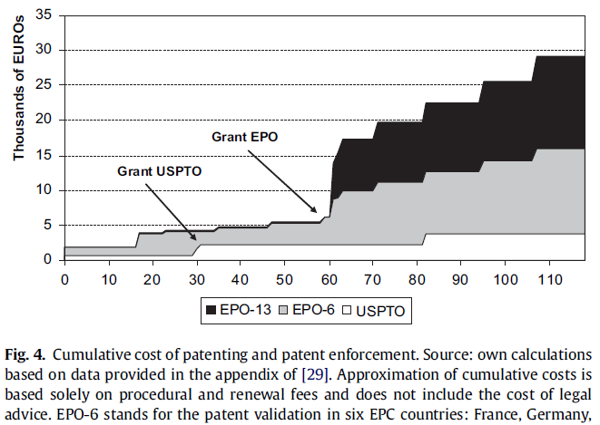

Slide 5
Prohibitively expensive, for wrong reasons
Uncertainty,
Parallell processes
Incongruous

Slide 6
A success?
Quality: yes
Stimulate innovators? Ask spin-offs

Slide 7
Do not expect much from the new ‘deal’
(Beside the nice Newspapers headings)
(a key first step, but only ‘first’)

Slide 8
The New Deal: adding a third layer…
National
European
EU now
Real EU?

Slide 9
An efficient European patent system…
Great move, we are close to it!!
Need for an exclusive EU patent (1 layer)
NPOs should change their business plan: e.g.,
Search services before priority filings?
Search reports during the first year (Paris Convention)?
Advices for filing strategies?
Advices for litigations?
FTO services?
PCT searches coordinated by EPO?
Support to the EPO ‘small’ ‘backlog’?

Slide 10
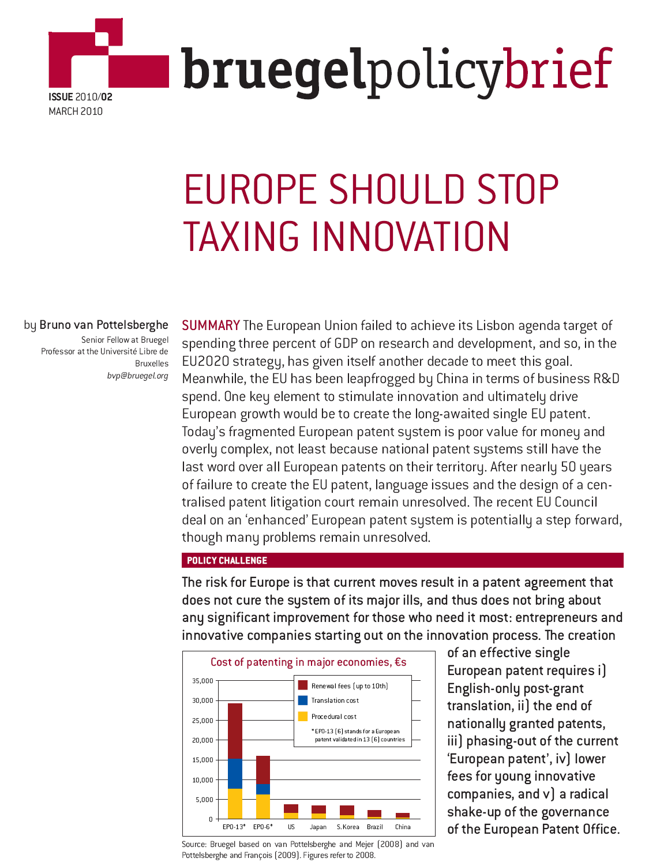

Slide 11
Main references
van Pottelsberghe de la Potterie B. and D. François, 2009, The cost factor in patent systems, Journal of Industry, Competition and Trade, 9(4), 329-355.
Danguy J. and B. van Pottelsberghe de la Potterie, 2011, Cost-Benefit Analysis of the Community Patent, Journal of Benefit-Cost Analysis (Berkeley Electronic Press), 2 (2), pp. 1-41.
Mejer M. and B. van Pottelsberghe de la Potterie, 2011, Patent backlogs at USPTO and EPO: Systemic failure vs deliberate delays, World Patent Information, 33(2), 122-127.
Mejer M. and B. van Pottelsberghe de la Potterie, 2012, Economic incongruities in the European patent system, European Journal of Law and Economics, forthcoming.
van Pottelsberghe de la Potterie B., 2011, The quality factor in patent systems, Industrial and Corporate Change, 20(6), 1755-1793.

Slide 12
Switching money flows: by actor, with 50,000 patents under COMPAT, (€ M)
 | EPO | NPOs | Business sector | Attorn. & transl. | Lawyers
Designation fees EPO^{α, β} | -25 |  | +40 | -15
Validation fees NPOs^{χ} |  | -10 | +10
Translation costs^{δ, ε} | -20 |  | +129 | -129
Filing patent translation^{α} |  |  | +60 | -60
Taking over representation^{α} |  |  | +46 | -46
Renewal fees^{ε} | +88 | +88 | -176
Intermediary cost for maintenance^{α} |  |  | +20 | -20
Drop in parallel litigation (Harhoff, 2009) ^{φ} |  |  | +121 |  | -121
Total | +43 | +78 | +250 | -270 | -121

