Slide 1
Institut der beim Europäischen Patentamt zugelassenen Vertreter Institute of Professional Representatives before the European Patent Office Institut des mandataires agréés près l'Office européen des brevets
Perspectives for Patent Law in the European Union
The epi view
Tony Tangena
epi President

Slide 2
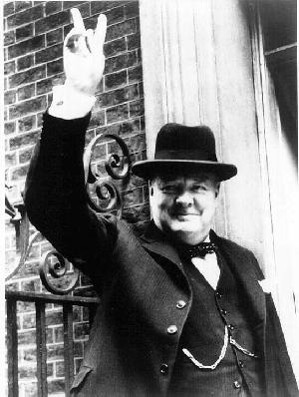
Towards a European Patent System
The pessimist sees difficulty in every opportunity
The optimist sees opportunity in every difficulty
Winston Churchill

Slide 3
Agenda:
Key issues for a European Patent System
The Granting System
The Litigation System

Slide 4
Key issues for a EU Patent system
The prime aim for an EU patent system is:
Tool to exploit the fruits of innovation
Protection of innovation in exchange for publication
Legal certainty and predictability
High Quality
Local support in all parts of the EU
Not too expensive
Do not fear going forward slowly
Fear only to stand still
Chinese proverb

Slide 5
Future EU patent system: Granting system
High quality Centralized Granting Organization: EPO
Substantive examination and granting
Coordination of activities with NPOs and epi:
Stimulation of inventions / Training / Access to patent information / General information to public
At local level support available, especially for SMEs:
EU patent attorneys (EPAs) access plus support
National Patent Offices (NPOs): general info and support
EPAs and NPOs work closely together
If you really want to do something you’ll find a way
If you don’t you’ll find an excuse
Anonymous

Slide 6
Future EU patent system: Litigation system
High quality Centralized Litigation Organization:
High quality
Harmonization
Between regional / national courts
Between EPO and Courts
National /regional level courts:
Access and support for SMEs by Attorneys at Law and EU patent attorneys in the countries
Role EU Patent Attorneys important:
Experience and training to deal with patents
Link EPO with Court system
If we cannot get what we like,
let us like what we can get
Spanish proverb

Slide 7
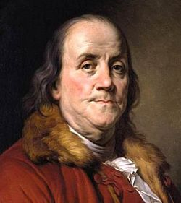
“Well-done is better
than well-said.”
Benjamin Franklin

Slide 8
Institut der beim Europäischen Patentamt zugelassenen Vertreter Institute of Professional Representatives before the European Patent Office Institut des mandataires agréés près l'Office européen des brevets
Thank you
for your attention!

